Slide 1
GENDER
NEUTRALITY

Slide 2
GENDER NEUTRALITY
PRESENTED TO
AINDRILA SAHA
ASSISTANT PROFESSOR OF ENGLISH
GURU NANAK INSTITUTE OF TECHNOLOGY

Slide 3
TEAM PROFILES:-
Sumit Bharti- 94
Tanima Sadhu- 99
Urmi Mishra- 102
Vineet Singh- 105
Debadyuti Modak- 111

Slide 4
TABLE OF CONTENTS
Introduction
Examples of Gender Neutrality
Benefits of Gender Neutrality
Challenges to Gender Neutrality
Articles supporting Gender Neutrality
Impacts of Gender Neutrality
Conclusion

Slide 5
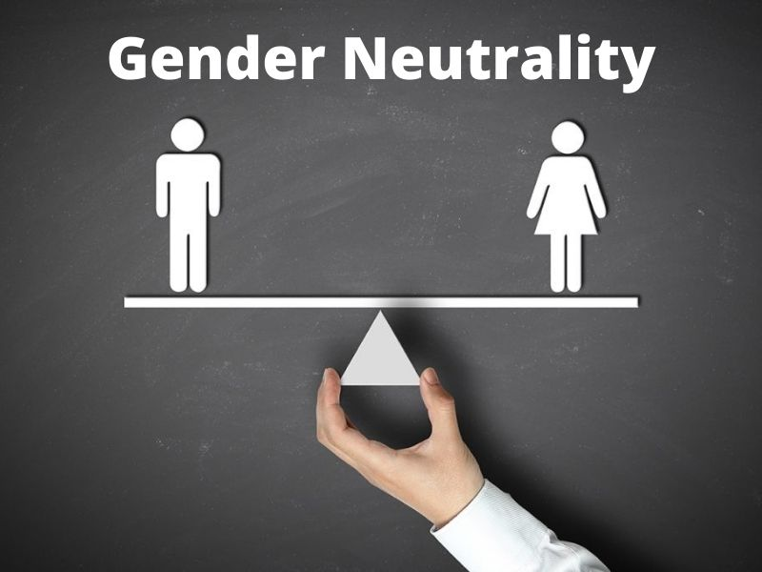
Introduction to Gender Neutrality
Gender neutrality refers to the practice of recognizing and accommodating all genders equally without favoring or prioritizing one over others. It aims to create an inclusive environment where individuals are not confined or discriminated against based on their gender identity or expression. This concept is particularly relevant in contexts such as language, policies, education, workplaces, and public spaces.

Slide 6
Examples of Gender Neutrality
Language: Using gender-neutral pronouns like "they/them" instead of "he/him" or "she/her." Referring to professions neutrally, such as "firefighter" instead of "fireman" or "chairperson" instead of "chairman.“
Public Spaces: Providing gender-neutral restrooms that can be used by anyone, regardless of their gender identity.
Workplace Policies: Implementing parental leave for "primary caregivers" rather than specifying "maternity" or "paternity" leave. Avoiding gender-specific dress codes and allowing employees to wear clothing they are comfortable in.
Education: Allowing students to choose uniforms or dress codes that align with their identity. Including gender-neutral terms and examples in curricula to foster inclusivity. 5. Technology: Many virtual assistants, such as AI voice systems, now use gender-neutral voices to avoid reinforcing stereotypes

Slide 7
Benefits of Gender Neutrality
Gender neutrality offers numerous benefits, including:
Promotes Equality: Gender neutrality fosters a culture of equality, where individuals are judged on their merits, not their gender.
Reduces Stereotyping: By avoiding gendered labels and expectations, individuals can express themselves freely, without conforming to societal norms.
Encourages Diversity and Inclusion: Gender-neutral environments welcome and value people of all gender identities, promoting diversity and inclusion.
Breaks Down Barriers: Gender neutrality helps dismantle barriers to education, employment, and healthcare, allowing individuals to pursue their goals without gender-based restrictions.
Fosters Creativity and Self-Expression: By removing gendered expectations, individuals can explore their interests, talents, and identities without constraint.
Supports Mental Health: Gender neutrality can reduce the pressure to conform to traditional gender roles, promoting mental well-being and self acceptance

Slide 8
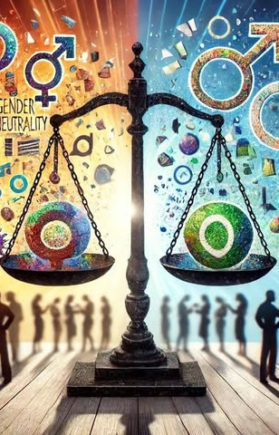
Challenges to Gender Neutrality
Social and Cultural Resistance:- Traditional Norms and Beliefs: Many societies adhere to strict binary gender roles, making it hard for individuals to accept and adapt to gender-neutral practices. Public Misconceptions: Some view gender-neutral policies as unnecessary or threatening to cultural and religious values.
Safety and Privacy Concerns:- Perceptions of Misuse: Opponents of gender-neutral restrooms claim they might be exploited for inappropriate behavior, although studies show little evidence supporting this concern. Balancing Privacy: Ensuring gender-neutral spaces meet everyone's needs without alienating particular groups can be challenging.
Workplace and Institutional Barriers:- Resistance in Workplaces: Gender-neutral policies like dress codes or inclusive parental leave can face pushback from employers who see them as disruptive or costly. Lack of Awareness: Many organizations fail to train employees adequately on using gender-neutral language and respecting diverse identities.
Education System Challenges:- Parental Concerns: Gender-neutral practices in schools, such as uniforms or curricula, often face resistance from parents who view them as inappropriate or unnecessary. Peer Bullying: Students advocating for or using gender-neutral facilities may face discrimination

Slide 9

Articles supporting Gender Neutrality
Article 14 Equality before law for women.
Article 15 Prohibition of discrimination on grounds of religion, race, caste, sex or place of birth.
Article 16 Equality of opportunity in matters of public employment.
Article 39 A Equal justice and free legal aid.
Article 42 Provision for just and humane conditions of work and maternity relief.

Slide 10
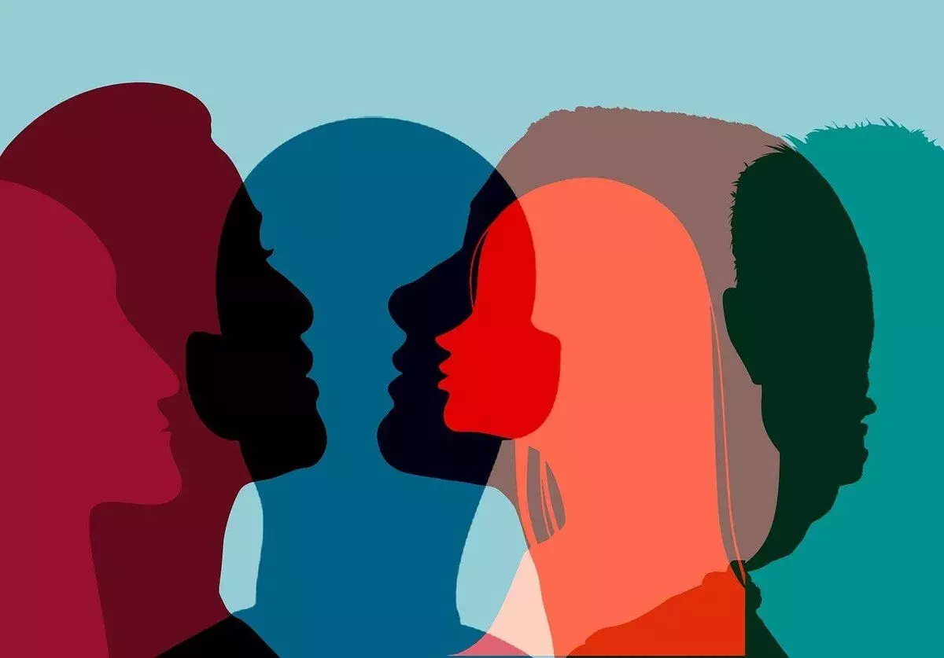
Impacts of Gender Neutrality
Creating a welcoming environment
Promoting inclusivity and diversity
Encouraging equality in the workplace
Creating a more welcoming environment in education
Changing the legal system
Challenging traditional roles and expectations

Slide 11
Conclusion
Gender neutrality paves the way for a fairer and more compassionate world. While implementing such changes requires effort and awareness, the long-term benefits in promoting equality, reducing discrimination, and fostering mutual respect make it a transformative movement for modern society.

Slide 12
THANK
YOU

